Slide 1
Shared Molecular Biomarkers
Between Heart Failure
and Breast Cancer
Bioinformatics Approach
Transcriptomic Analysis
A Transcriptomic Analysis Investigating
Bidirectional Relationships Through Bioinformatics
• Gene Expression Profiling
• Pathway Integration Analysis
• Cross-Condition Biomarker Discovery
December 2025
Cardio-Oncology Research
RESEARCH FOCUS

Slide 2
Table of Contents
01
Background & Introduction
07
Clinical Implications
02
Molecular Convergence
08
Conclusions
03
Bidirectional Relationship
09
Future Directions
04
Hypothesis & Objectives
05
Methodology Workflow
06
Expected Results
Shared Molecular Biomarkers: Heart Failure & Breast Cancer
02

Slide 3
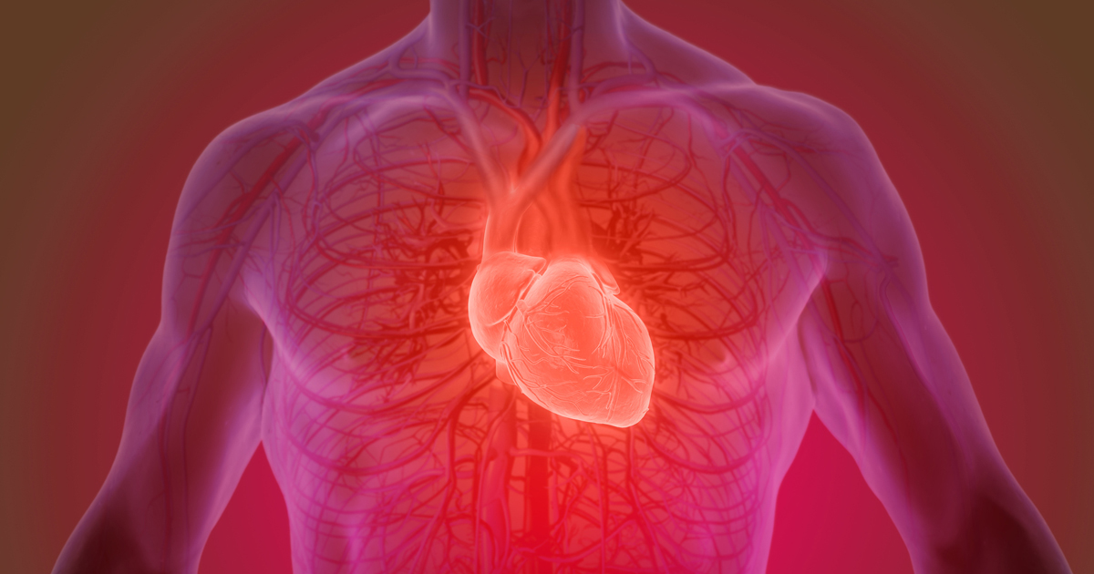
Global Health Impact
Heart failure and breast cancer represent two of the most prevalent and clinically
significant diseases worldwide, each contributing substantially to global morbidity
and mortality.
Distinct organ systems with fundamentally different pathological mechanisms
Growing evidence of converging biological pathways
Key shared processes: chronic inflammation, oxidative stress, metabolic dysregulation,
hormonal signaling
Shared Molecular Biomarkers: Heart Failure & Breast Cancer
03

Slide 4
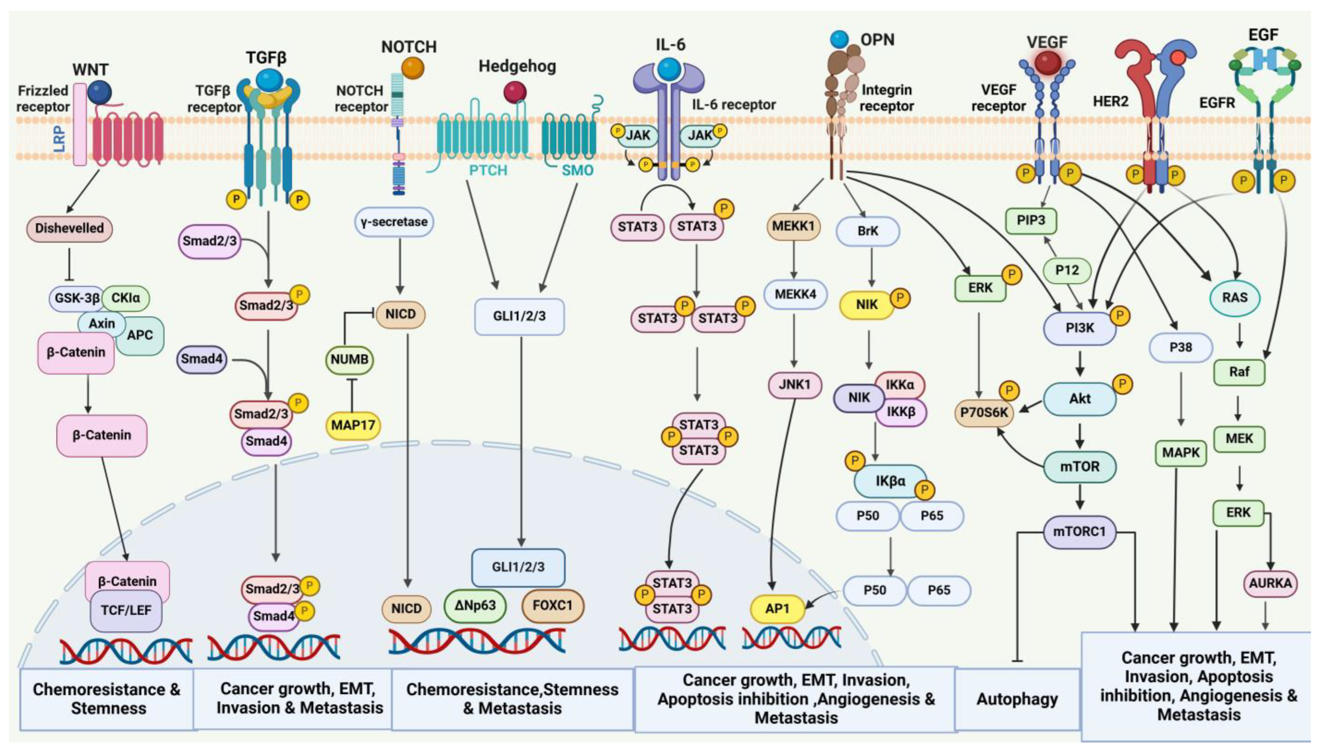
Shared Molecular Pathways
Signaling Cascades
PI3K/AKT, MAPK, and NF-
κ
B pathways implicated in both heart failure and
breast cancer progression
Epigenetic Alterations
MicroRNA networks and epigenetic modifications contribute to disease
development in both conditions
Systems Biology Insights
Advanced molecular profiling reveals overlapping mechanisms and potential
therapeutic intersections
Foundation for interdisciplinary research aimed at identifying overlapping biomarkers
and risk factors

Slide 5
CVD-Cancer Bidirectional Connection
Cardiovascular
Breast
Disease
Cancer
Cardiotoxicity Variability
Cancer Recurrence
Not all cancer patients develop cardiotoxicity
→
genetic susceptibility
Higher rates in patients with pre-existing CVD
→
cardiovascular
factors determine individual risk
dysfunction may influence tumor progression
Preclinical Evidence
Clinical Observations
MI accelerates breast cancer tumor growth in mice
→
significantly
CVD patients diagnosed with cancer at advanced stages with
increased tumor volume
increased metastatic potential
Immune Suppression Mechanism
Certain cardiovascular disorders induce systemic immune suppression
→
creating permissive environment for tumor initiation or recurrence

Slide 6
Research Hypothesis & Aims
HYPOTHESIS
CVDs may promote breast cancer development and recurrence through shared molecular biomarkers
Primary Objective
Identify potential shared biomarkers and pathways between BC and CVD through transcriptomic analysis
Specific Aims
1
2
3
Analyze DEGs
Compare Patterns
Identify Pathways
Analyze DEGs in BC patients receiving
Compare with CVD-related gene
Identify overlapping pathways
non-cardiotoxic hormonal therapy
expression patterns
implicated in both conditions
Shared Molecular Biomarkers: Heart Failure & Breast Cancer
06

Slide 7
Bioinformatics Workflow Overview
Analysis Pipeline
Data Source
1
Data Acquisition & Quality Control
Microarray data from GEO
Download raw data, assess technical quality, detect outliers
• GSE109169 - Breast Cancer
• Heart Failure datasets
2
Preprocessing & Normalization (RMA)
Background correction, quantile normalization, probe annotation
Sample Type
3
Differential Expression Analysis (limma)
Whole blood samples (minimally invasive, reflects systemic
Identify DEGs with statistical significance and fold-change thresholds
changes)
4
Functional Enrichment (GO, KEGG, GSEA)
Platform
Identify biological pathways and molecular functions
RStudio with specialized bioinformatics packages
5
Cross-Condition Integration (Venn Analysis)
Identify overlapping DEGs and shared pathways between BC and HF

Slide 8
Results: Two-Part Analysis
Differential Gene Expression
Machine Learning Feature
1
2
Analysis
Selection
Quality control and normalization
LASSO regression for sparse feature selection
Identification of up/downregulated genes
Random Forest classification and importance
Functional pathway enrichment (GO, KEGG)
ranking
Biological process interpretation
Consensus biomarker identification
Model performance evaluation
Integrated Approach: Combining traditional differential expression analysis with machine learning methods to identify robust
molecular biomarkers for cardio-oncology applications
Cardio-Oncology Biomarkers | Transcriptomic Analysis
08

Slide 9
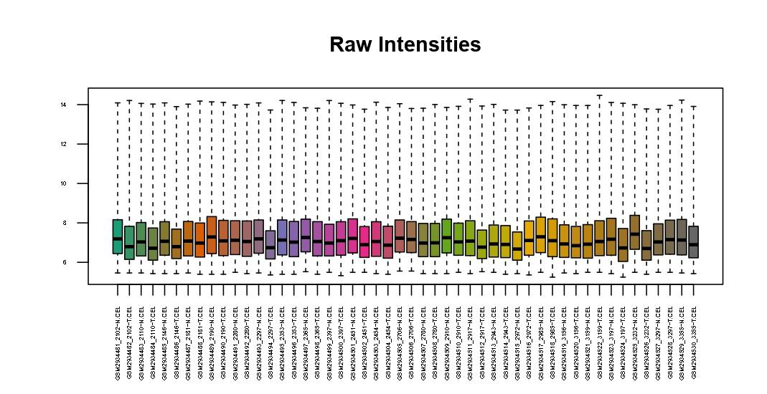
Data Quality Assessment
Quality Control - Raw Data Distribution
Key Observations
Consistent distributions across all samples with median
intensities around 6-8 on log scale
Uniform variance patterns indicate high data quality
No outlier samples detected requiring removal
Data suitable for downstream differential expression
analysis
Conclusion: The consistent raw intensity distributions and
uniform variance patterns validate the technical quality of the
microarray data, confirming readiness for normalization and
differential expression analysis.
Cardio-Oncology Biomarkers | Transcriptomic Analysis
08

Slide 10
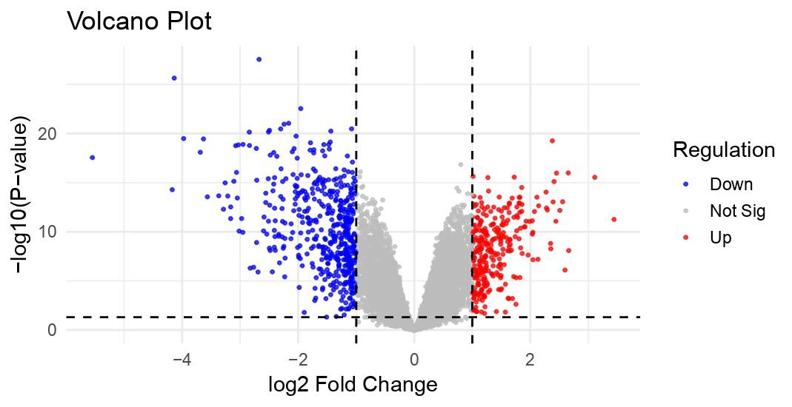
Principal Component Analysis of Top 50 DEGs
Key Findings
Clear separation between breast cancer tissue and normal adjacent
tissue validates the biological significance of identified DEGs
PC1 (33.9%)
Captures primary variance - strong horizontal separation between cancer and
normal groups
PC2 (12.7%)
Captures secondary variance - within-group biological variability
Total Variance: 46.6%
First two components explain nearly half of total gene expression variation
Sample Clustering
Tight clustering within groups demonstrates consistent gene expression patterns
and validates sample quality
Cardio-Oncology Biomarkers | Transcriptomic Analysis
08

Slide 11
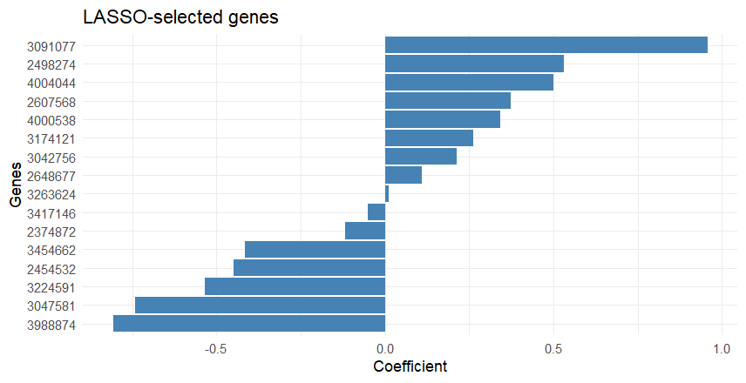
Differential Expression Landscape
Volcano Plot - Genome-Wide Expression Changes
Key Findings
Genome-wide transcriptomic analysis reveals extensive differential
expression between breast cancer and normal tissue
Upregulated genes (red)
Positive log2FC, enriched in cancer tissue
Downregulated genes (blue)
Negative log2FC, depleted in cancer tissue
Asymmetric pattern
More genes downregulated than upregulated
Strong effect sizes
Some genes show >4-fold changes
High statistical confidence
Many DEGs with p-value < 1×10
¹⁵
⁻
Interpretation: The extensive differential expression pattern suggests major
transcriptional reprogramming in breast cancer tissue
Cardio-Oncology Biomarkers | Transcriptomic Analysis
08

Slide 12
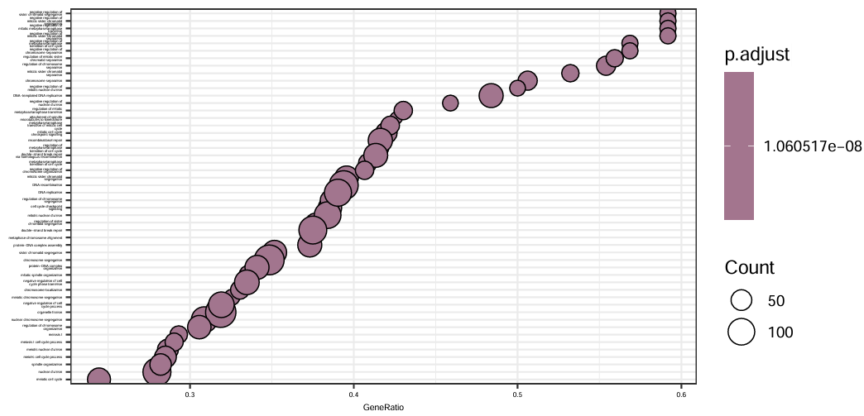
Gene Expression Heatmap - Top 50 DEGs
Sample Clustering
Clear separation between cancer (right) and normal (left) tissues. Tight clustering validates
biological consistency within groups.
Upregulated Cluster (Red)
Key genes: FGF5, SERPINA3, TNFRSF11, SFRP1/2, INHBA, TGFB1
• Growth factors and signaling molecules
• ECM remodeling markers
• Enhanced cell communication
Downregulated Cluster (Blue)
Key genes: CENPF, NUSAP1, CENPA, PRDM8
• Cell cycle and proliferation genes
• Mitotic regulators
• Reduced proliferative activity
Interpretation: Expression pattern suggests transition from proliferation to
differentiation/remodeling state in breast cancer tissue.

Slide 13
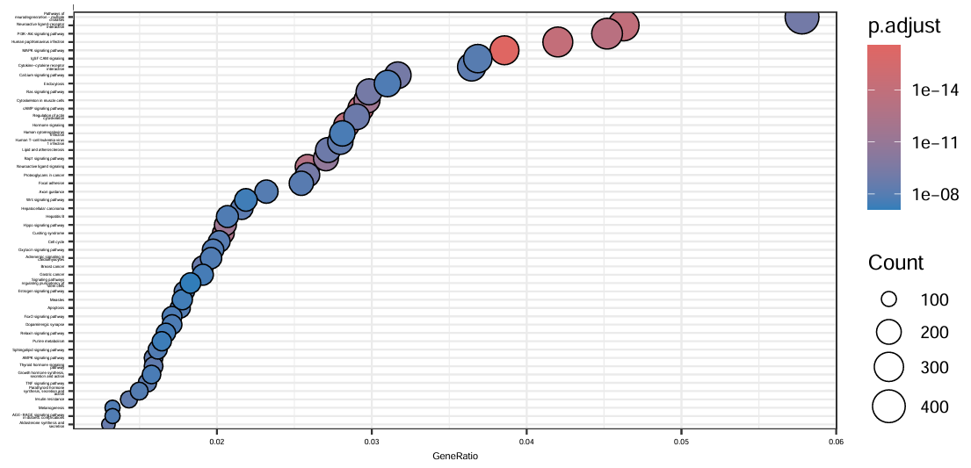
GO Enrichment - Altered Biological Pathways
Top Enriched Pathways
All pathways highly significant (p.adjust < 1×10
⁸)
⁻
Tissue Morphogenesis & Development
Epithelial cell development, embryonic morphogenesis, anatomical structure
formation
Cell Adhesion & Communication
Cell-cell junction assembly, biological adhesion, plasma membrane interactions
Metabolic Regulation
Carboxylic acid biosynthesis, amino acid metabolism, small molecule
biosynthesis
Interpretation: Gene ratio 0.3-0.65 indicates substantial pathway
involvement. Findings consistent with tissue remodeling and cellular
differentiation in breast cancer.
Cardio-Oncology Biomarkers | Transcriptomic Analysis
08

Slide 14
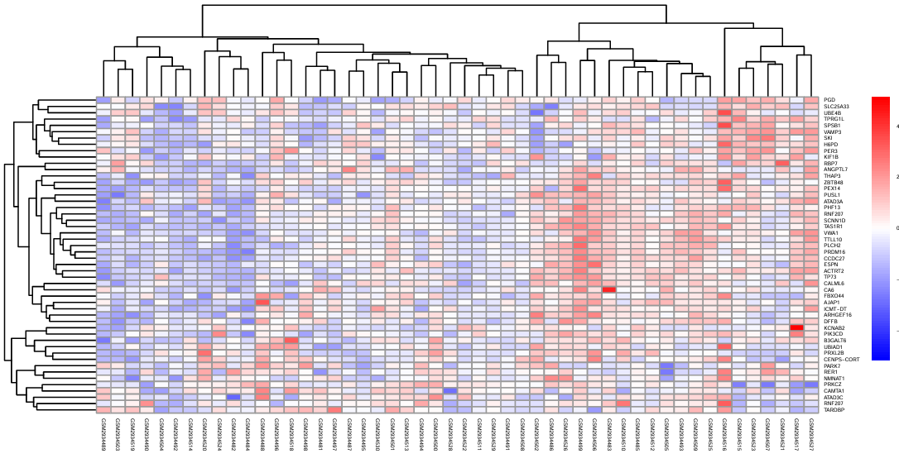
Functional Enrichment - Cellular Components
GO cellular component analysis reveals widespread reorganization of
subcellular architecture
Membrane Structures
Apical plasma membrane, cell-cell junctions altered
Signaling Complexes
Receptor complexes, signaling pathway components
Cytoskeletal Elements
Supramolecular complexes, cell projections
Extracellular Matrix
Collagen-containing ECM, basement membrane
High gene counts (up to 400+ genes) with extreme significance (p < 1×10
¹⁴)
⁻
indicate widespread cellular architecture reorganization
Cardio-Oncology Biomarkers | Transcriptomic Analysis
08

Slide 15
Literature-Identified Genes: Dual Roles in BC & CVD
Key genes identified from literature review with documented roles in both breast cancer and cardiovascular disease
Gene Symbol
Cancer Association
Cardiovascular Association
LRRC15
Tumor stroma marker; myofibroblast determinant in cancer immunotherapy response
Cardiac fibrosis; shared TGF-
β
pathway activation
SPP1
Promotes cancer stemness via vitronectin signaling; enriched in tumor macrophages
Atherosclerosis progression; cardiac remodeling marker
CDC20, CCNA2, CCNB1
Cell cycle regulators in glioblastoma and multiple cancers
Cardiac hypertrophy; proliferation in cardiovascular remodeling
Histone genes (H2BC14, H2AC16,
Epigenetic regulation; chromatin remodeling in tumorigenesis
Cardiovascular epigenetic regulation; BET reader proteins in CVD
H3C2)
ABCA1, SREBP2, PPAR
γ
Lipid metabolism in cancer cells; regulated by miRNAs
Cholesterol efflux; atherosclerosis prevention; lipid homeostasis
CFB, C4B, COL10A1, COL12A1
Complement activation; ECM remodeling in tumor microenvironment
Inflammation; tissue remodeling in heart failure
ICAM5, MMP12, PLAUR
Cell adhesion; matrix degradation; metastasis promotion
Plasma proteins linked to heart failure; vascular inflammation
JCAD
Endothelial dysfunction; promotes cancer progression
Novel CAD risk gene; atherosclerosis development
FOXO1, CCR7
Tumor suppressor; regulates cell survival and apoptosis
Oxidative stress response; blood marker in coronary artery disease
S100A8/A9, NLRP3
Inflammation; immune response in tumor microenvironment
NLRP3 inflammasome activation; cardiac inflammation
JAK-STAT pathway
Oncogenic signaling; cancer cell proliferation and survival
Inflammation in CVD; myeloproliferative neoplasms
GATA3
Transcription factor; breast cancer subtype marker
Vascular biology; inflammation regulation in CVD
PLAU
ECM remodeling; cancer invasion and metastasis
Atherosclerosis; plaque instability
MMP1/12/13
ECM degradation; tumor invasion and metastasis
Plaque instability; vascular remodeling
OLR1
Oxidized LDL receptor; promotes cancer cell growth
Atherosclerosis; oxidative stress in vessels
CHEK1
DNA damage response; cell cycle checkpoint in cancer
Therapy-induced cardiovascular toxicity; DNA damage in CVD
CDK1, FOXM1, MKI67
Cell cycle progression; proliferation markers in cancer
Cardiac hypertrophy; cardiomyocyte proliferation
IL6
Promotes tumor growth, metastasis, therapy resistance
Central inflammatory cytokine; atherosclerosis driver
EGFR
Major oncogene; receptor tyrosine kinase in multiple cancers
Vascular remodeling; atherosclerosis regulation
CD36
T
h
i
l
d li
id
b li
Li
id
k
h
l
i
b li
d
Cardio-Oncology Biomarkers
15

Slide 16
Machine Learning Feature Selection
Two complementary machine learning approaches for identifying predictive biomarkers
LASSO Regression
Random Forest
Least Absolute Shrinkage and Selection Operator
Ensemble Decision Tree Classifier
L1 Regularization: Penalizes absolute coefficient values
Ensemble Learning: Combines 1000 decision trees
Sparse Model: Automatically selects minimal gene set
Non-Linear: Captures complex gene interactions
Linear Model: Direct coefficient interpretation
Importance Ranking: Gini impurity-based scoring
Handles Collinearity: Selects one from correlated genes
Robust: Resistant to overfitting through bagging
Best For:
Best For:
Minimal diagnostic panels, clinical biomarker development
Complex pattern discovery, pathway interaction analysis
Complementary Approach: LASSO identifies minimal biomarker sets with linear relationships, while Random Forest captures non-linear interactions
and broader feature importance. Together, they provide robust consensus biomarkers.
Cardio-Oncology Biomarkers | Transcriptomic Analysis
08

Slide 17
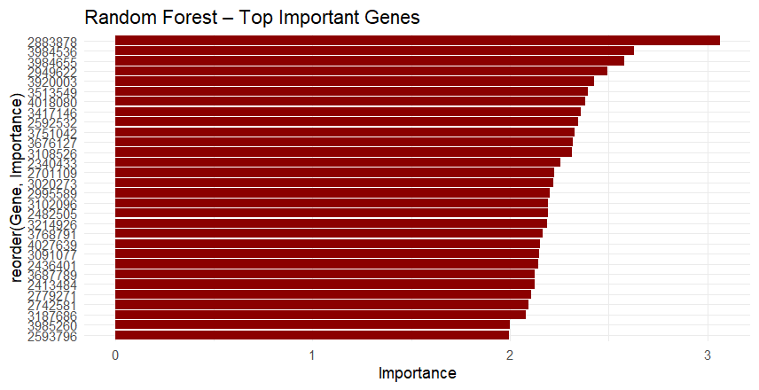
LASSO Regression - Minimal Biomarker Panel
17 Genes Selected
From thousands of genes through L1 regularization
Positive Coefficients
Upregulated in cancer:
3091077 (strongest), 2498274, 4004044, 2607568, 4000538, 3174121,
3042756, 2648677, 3263624
Negative Coefficients
Downregulated in cancer:
3988874, 3047581, 3224591, 2454532, 3454662, 2374872, 3417146
Sparse model minimizes overfitting and identifies essential biomarkers
for potential minimal diagnostic panel development
Cardio-Oncology Biomarkers | Transcriptomic Analysis
08

Slide 18
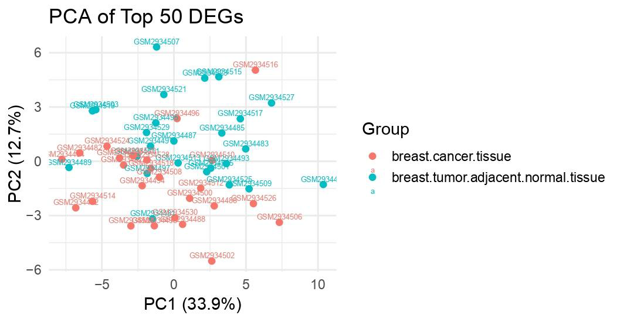
Random Forest - Top Predictive Features
Key Findings
Top 30 genes ranked by importance score
Highest importance: 2883878 (3.0), 388456 (2.9), 2934536 (2.8)
Ensemble consensus across 1000 decision trees
Interpretation
Captures non-linear interactions and complex patterns
Complementary to LASSO: Different selection criteria, broader feature set
Gradual importance decline suggests multiple genes contribute meaningfully
Clinical Potential: These genes represent stable biomarkers validated through
ensemble learning, suitable for further experimental validation
Cardio-Oncology Biomarkers | Transcriptomic Analysis
08

Slide 19
Integrated Findings & Consensus Biomarkers
Molecular Signature Identified
Biological Processes Altered
Clinical Relevance
17
LASSO-Selected Genes
Proliferation
→
Differentiation
Minimal diagnostic panel through L1 regularization
Strong Discriminative Power
Downregulation of cell cycle genes (CENP family, NUSAP1)
46.6% variance explained by top 2 PCs; clear sample
30
RF-Important Genes
separation
Comprehensive feature set capturing non-linear
Tissue Remodeling
interactions
ECM reorganization and cytoskeletal changes
Biomarker Potential
✓
Consensus Biomarkers
Enhanced Cell Signaling
Overlapping genes for validation and clinical testing
Minimal gene panel for early detection and risk
Upregulation of FGF5, TGFB1, INHBA pathways
stratification
Metabolic Reprogramming
Altered amino acid and carboxylic acid metabolism
Therapeutic Targets
Upregulated signaling molecules as intervention
candidates
Validation Ready
Consensus genes prioritized for experimental confirmation

Slide 20
Literature vs ML Biomarkers Comparison
Literature Review
ML Analysis
Overlap
54
47
0
Genes identified
Genes selected (LASSO + RF)
Direct matches
Literature-Identified Genes (Selected Examples)
ML-Generated Biomarkers (Probe IDs)
Key pathways represented:
LASSO-selected (17 genes):
Inflammation & Immune:
3091077
2498274
4004044
2607568
4000538
3174121
3042756
2648677
IL6
S100A8/A9
S100B
NLRP3
CCR7
ICAM5
3263624
3988874
3047581
3224591
2454532
3454662
2374872
3417146
Lipid Metabolism:
ABCA1
CD36
FABP4
FADS2
OLR1
SREBP2
Random Forest top genes (30 shown):
Cell Cycle & Proliferation:
2883878
388456
2934536
392003
3613549
4018080
3347146
2624273
CDC20
CCNA2
CCNB1
CDK1
CHEK1
MKI67
3751042
3676127
3108526
2340433
4001179
2026263
2956579
3102096
ECM & Remodeling:
2482504
MMP1/12/13
COL10A1
PLAU
PLAUR
SPP1
Signaling & Growth:
Key Finding: No direct overlap between literature-identified gene symbols and ML probe IDs. This highlights the need for probe-to-gene annotation mapping to identify true convergence. Literature genes
represent known BC-CVD pathways (inflammation, lipid metabolism, ECM remodeling), while ML analysis provides data-driven, unbiased biomarker discovery from transcriptomic patterns.

Slide 21
Expected Results - Shared Biomarkers
Anticipated findings from transcriptomic analysis
1
2
3
Overlapping DEGs
Common Pathways
Cardiotoxicity Predictors
Genes dysregulated in both breast cancer
Shared molecular mechanisms linking
Genetic signatures distinguishing
and cardiovascular disease datasets
both conditions
susceptible vs resistant patients
Key Pathways Expected to be Identified:
Inflammatory signaling: NF-
κ
B pathway, cytokine networks
Oxidative stress response: ROS regulation, antioxidant pathways
Metabolic dysregulation: Energy metabolism, mitochondrial
Signaling cascades: PI3K/AKT, MAPK pathways
function
Shared Molecular Biomarkers: Heart Failure & Breast Cancer
08

Slide 22
Clinical Implications
Translational Impact
From Discovery to Clinical Application
Biomarker
Risk
Therapeutic
Personalized
Discovery
Stratification
Targets
Medicine
Risk Stratification
Biomarker Development
Therapeutic Targets
Early identification of high-risk patients for cardiotoxicity
Predictive markers for cardiotoxicity susceptibility and
Shared pathways enabling dual intervention strategies for
and cancer recurrence
treatment response
both conditions
Personalized Medicine
Clinical Monitoring
Drug Development
Tailored treatment strategies based on individual
Biomarker-guided surveillance during cancer therapy to
Novel therapeutic approaches targeting common
molecular profiles
prevent cardiac complications
molecular mechanisms
Sh
d M l
l
Bi
k
H
t F il
& B
t C
09

Slide 23
Conclusions
Key Conclusions
Summary of Major Findings
1
Bioinformatics approach enables systematic identification of shared molecular mechanisms between heart failure and breast cancer through transcriptomic
analysis
2
Transcriptomic analysis reveals overlapping pathways between BC and CVD, including inflammatory signaling, oxidative stress, and metabolic dysregulation
3
Whole blood analysis provides minimally invasive biomarker discovery platform suitable for clinical translation and patient monitoring
4
Integration of multiple datasets strengthens evidence for shared pathophysiology and supports the bidirectional CVD-cancer relationship hypothesis
5
Findings support bidirectional CVD-cancer relationship and provide foundation for developing predictive biomarkers and therapeutic interventions targeting
shared pathways

Slide 24
Future Directions
Next Steps in Cardio-Oncology Research
1
Validation Studies
Independent cohort validation of identified biomarkers across diverse patient populations
2
Functional Studies
Mechanistic investigation of shared pathways through in vitro and in vivo models
3
Longitudinal Analysis
Temporal dynamics of biomarker expression during disease progression and treatment
4
Multi-omics Integration
Combine transcriptomics with proteomics, metabolomics, and epigenomics for comprehensive profiling
5
Cli
i
l T i
l

Slide 25
Thank You
Questions?
For further information or collaboration inquiries
contact@research.institution
Shared Molecular Biomarkers: Heart Failure & Breast Cancer
12

